Slide 1

CHAPTER 4
ELEMENTARY NUMBER THEORY AND METHODS OF PROOF
Copyright © Cengage Learning. All rights reserved.

Slide 2
SECTION 4.1
Direct Proof and Counterexample I:Introduction
Copyright © Cengage Learning. All rights reserved.

Slide 3
Direct Proof and Counterexample I: Introduction
Both discovery and proof are integral parts of problem solving. When you think you have discovered that a certain statement is true, try to figure out why it is true.
If you succeed, you will know that your discovery is genuine. Even if you fail, the process of trying will give you insight into the nature of the problem and may lead to the discovery that the statement is false.

Slide 4
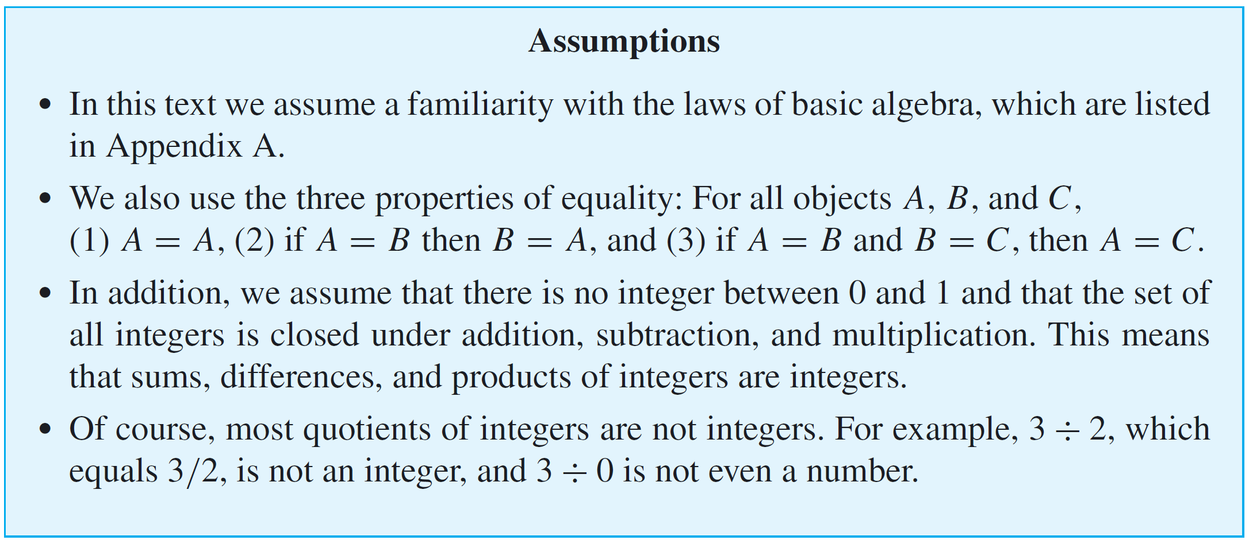
Direct Proof and Counterexample I: Introduction
For complex problems, the interplay between discovery and proof is not reserved to the end of the problem-solving process but, rather, is an important part of each step.

Slide 5
Definitions

Slide 6
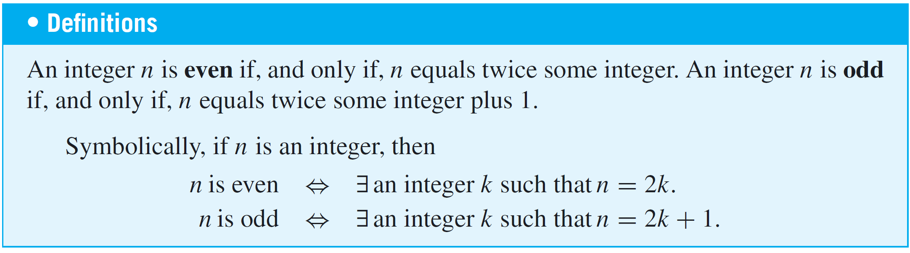
Definitions
In order to evaluate the truth or falsity of a statement, you must understand what the statement is about. In other words, you must know the meanings of all terms that occur in the statement. Mathematicians define terms very carefully and precisely and consider it important to learn definitions virtually word for word.

Slide 7
Example 1 – Even and Odd Integers
Use the definitions of even and odd to justify your answers to the following questions.
a. Is 0 even?
b. Is −301 odd?
c. If a and b are integers, is 6a²b even?
d. If a and b are integers, is 10a + 8b + 1 odd?
e. Is every integer either even or odd?
Solution:
a. Yes, 0 = 2·0.
b. Yes, –301 = 2(–151) + 1.

Slide 8
Example 1 – Solution
cont’d
c. Yes, 6a²b = 2(3a²b), and since a and b are integers, so is 3a²b (being a product of integers).
d. Yes, 10a + 8b + 1 = 2(5a + 4b) + 1, and since a and b are integers, so is 5a + 4b (being a sum of products of integers).
e. The answer is yes, although the proof is not obvious.

Slide 9
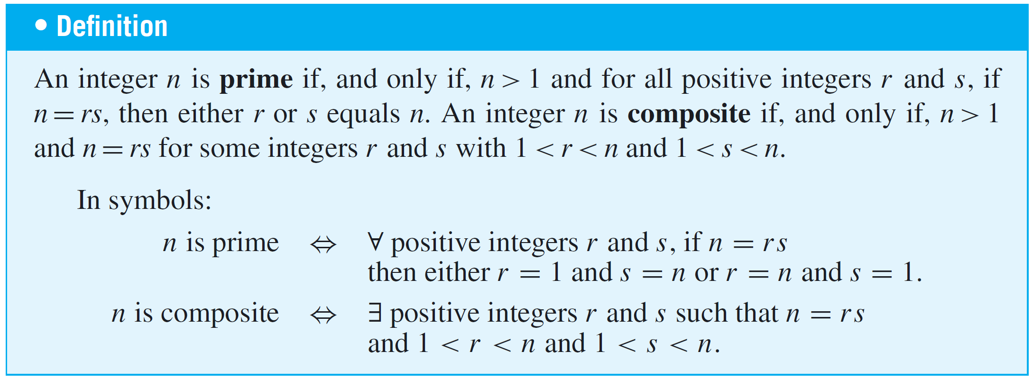
Definitions
The integer 6, which equals 2  3, is a product of two smaller positive integers.
On the other hand, 7 cannot be written as a product of two smaller positive integers; its only positive factors are 1 and 7. A positive integer, such as 7, that cannot be written as a product of two smaller positive integers is called prime.

Slide 10
Example 2 – Prime and Composite Numbers
a. Is 1 prime?
b. Is every integer greater than 1 either prime or composite?
c. Write the first six prime numbers.
d. Write the first six composite numbers.
Solution:
a. No. A prime number is required to be greater than 1.
b. Yes. Let n be any integer that is greater than 1. Consider all pairs of positive integers r and s such that n = rs. There exist at least two such pairs, namely r = n and
s = 1 and r = 1 and s = n.

Slide 11
Example 2 – Solution
cont’d
Moreover, since n = rs, all such pairs satisfy the
inequalities 1 ≤ r ≤ n and 1 ≤ s ≤ n. If n is prime, then the
two displayed pairs are the only ways to write n as rs.
Otherwise, there exists a pair of positive integers r and s
such that n = rs and neither r nor s equals either 1 or n.
Therefore, in this case 1 < r < n and 1 < s < n, and hence
n is composite.
c. 2, 3, 5, 7, 11, 13
d. 4, 6, 8, 9, 10, 12

Slide 12
Proving Existential Statements

Slide 13
Proving Existential Statements
We have known that a statement in the form
∃x ∈ D such that Q(x)
is true if, and only if,
Q(x) is true for at least one x in D.
One way to prove this is to find an x in D that makes Q(x) true.
Another way is to give a set of directions for finding such an x. Both of these methods are called constructive proofs of existence.

Slide 14
Example 3 – Constructive Proofs of Existence
a. Prove the following: ∃ an even integer n that can be written in two ways as a sum of two prime numbers.
b. Suppose that r and s are integers. Prove the following: ∃ an integer k such that 22r + 18s = 2k.
Solution:
a. Let n = 10. Then 10 = 5 + 5 = 3 + 7 and 3, 5, and 7 are
all prime numbers.
b. Let k = 11r + 9s.

Slide 15
Example 3 – Solution
cont’d
Then k is an integer because it is a sum of products of integers; and by substitution, 2k = 2(11r + 9s), which equals 22r + 18s by the distributive law of algebra.

Slide 16
Proving Existential Statements
A nonconstructive proof of existence involves showing either (a) that the existence of a value of x that makes Q(x) true is guaranteed by an axiom or a previously proved theorem or (b) that the assumption that there is no such x leads to a contradiction.
The disadvantage of a nonconstructive proof is that it may give virtually no clue about where or how x may be found.

Slide 17
Disproving Universal Statements by Counterexample

Slide 18
Disproving Universal Statements by Counterexample
To disprove a statement means to show that it is false. Consider the question of disproving a statement of the form
∀x in D, if P(x) then Q(x).
Showing that this statement is false is equivalent to showing that its negation is true. The negation of the statement is existential:
∃x in D such that P(x) and not Q(x).

Slide 19
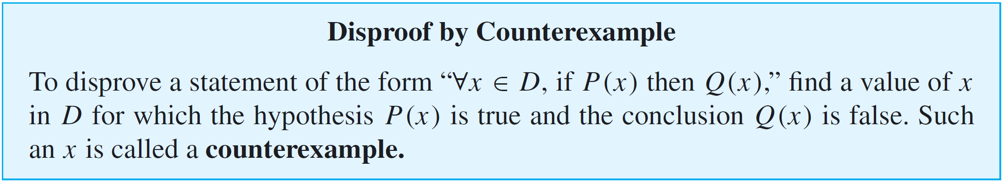
Disproving Universal Statements by Counterexample
But to show that an existential statement is true, we generally give an example, and because the example is used to show that the original statement is false, we call it a counterexample. Thus the method of disproof by counterexample can be written as follows:

Slide 20
Example 4 – Disproof by Counterexample
Disprove the following statement by finding a counterexample:
∀ real numbers a and b, if a² = b² then a = b.
Solution:
To disprove this statement, you need to find real numbers a and b such that the hypothesis a² = b² is true and the conclusion a = b is false.
The fact that both positive and negative integers have positive squares helps in the search.

Slide 21
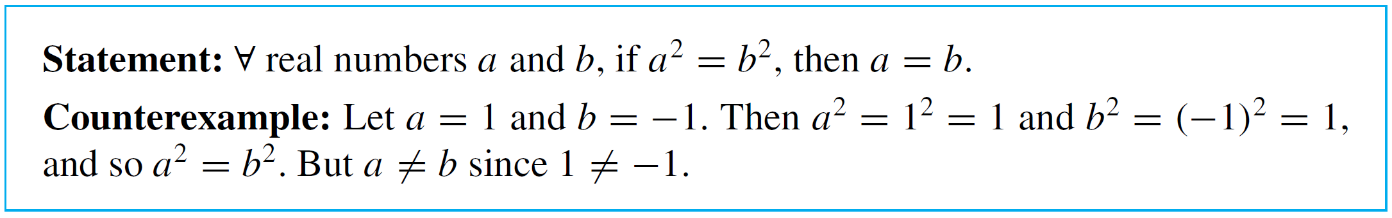
Example 4 – Solution
cont’d
If you flip through some possibilities in your mind, you will quickly see that 1 and –1 will work (or 2 and –2, or 0.5 and –0.5, and so forth).

Slide 22
Proving Universal Statements

Slide 23
Proving Universal Statements
The vast majority of mathematical statements to be proved are universal. In discussing how to prove such statements, it is helpful to imagine them in a standard form:
∀x ∈ D, if P(x) then Q(x).
When D is finite or when only a finite number of elements satisfy P(x), such a statement can be proved by the method of exhaustion.

Slide 24
Example 5 – The Method of Exhaustion
Use the method of exhaustion to prove the following statement:
∀n ∈ Z, if n is even and 4 ≤ n ≤ 26, then n can be written
as a sum of two prime numbers.
Solution:

Slide 25
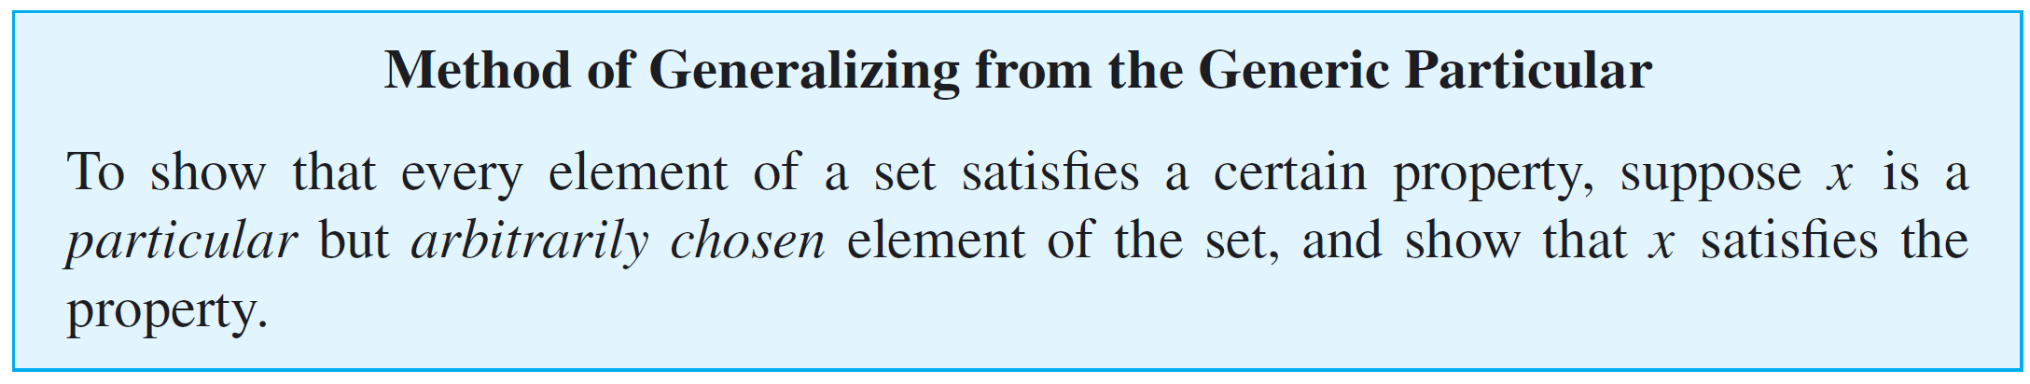
Proving Universal Statements
The most powerful technique for proving a universal statement is one that works regardless of the size of the domain over which the statement is quantified.
It is called the method of generalizing from the generic particular. Here is the idea underlying the method:

Slide 26
Example 6 – Generalizing from the Generic Particular
At some time you may have been shown a “mathematical trick” like the following.
You ask a person to pick any number, add 5, multiply by 4, subtract 6, divide by 2, and subtract twice the original number.
Then you astound the person by announcing that their final result was 7. How does this “trick” work?

Slide 27
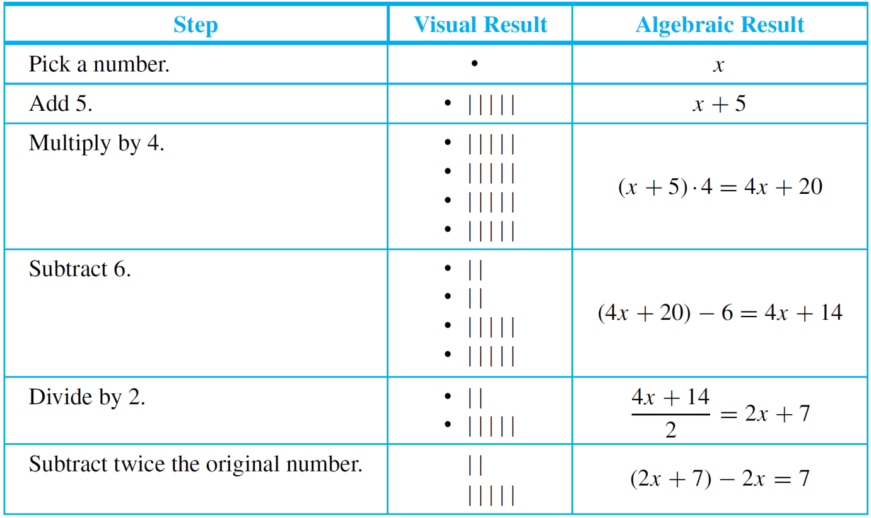
Example 6 – Generalizing from the Generic Particular
cont’d
Let an empty box  or the symbol x stand for the number the person picks.
Here is what happens when the person follows your directions:

Slide 28
Example 6 – Generalizing from the Generic Particular
cont’d
Thus no matter what number the person starts with, the result will always be 7.
Note that the x in the analysis above is particular (because it represents a single quantity), but it is also arbitrarily chosen or generic (because any number whatsoever can be put in its place).
This illustrates the process of drawing a general conclusion from a particular but generic object.

Slide 29
Proving Universal Statements
When the method of generalizing from the generic particular is applied to a property of the form “If P(x) then
Q(x),” the result is the method of direct proof.
We have known that the only way an if-then statement can be false is for the hypothesis to be true and the conclusion to be false.
Thus, given the statement “If P(x) then Q(x),” if you can show that the truth of P(x) compels the truth of Q(x), then you will have proved the statement.

Slide 30
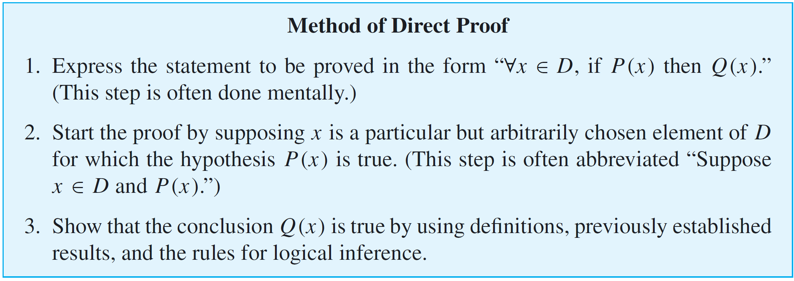
Proving Universal Statements
It follows by the method of generalizing from the generic particular that to show that “∀x, if P(x) then Q(x),” is true for all elements x in a set D, you suppose x is a particular but arbitrarily chosen element of D that makes P(x) true, and then you show that x makes Q(x) true.

Slide 31
Example 7 – A Direct Proof of a Theorem
Prove that the sum of any two even integers is even.
Solution:
Whenever you are presented with a statement to be proved, it is a good idea to ask yourself whether you believe it to be true.
In this case you might imagine some pairs of even integers, say 2 + 4, 6 + 10, 12 + 12, 28 + 54, and mentally check that their sums are even.

Slide 32
Example 7 – Solution
cont’d
However, since you cannot possibly check all pairs of even numbers, you cannot know for sure that the statement is true in general by checking its truth in these particular instances.
Many properties hold for a large number of examples and yet fail to be true in general.
To prove this statement in general, you need to show that no matter what even integers are given, their sum is even. But given any two even integers, it is possible to represent them as 2r and 2s for some integers r and s.

Slide 33
Example 7 – Solution
cont’d
And by the distributive law of algebra, 2r + 2s = 2(r + s), which is even. Thus the statement is true in general.
Suppose the statement to be proved were much more complicated than this. What is the method you could use to derive a proof?
Formal Restatement: ∀ integers m and n, if m and n are
even then m + n is even.
This statement is universally quantified over an infinite domain. Thus to prove it in general, you need to show that no matter what two integers you might be given, if both of them are even then their sum will also be even.

Slide 34
Example 7 – Solution
cont’d
Next ask yourself, “Where am I starting from?” or “What am I supposing?” The answer to such a question gives you the starting point, or first sentence, of the proof.
Starting Point: Suppose m and n are particular but
arbitrarily chosen integers that are even.
Or, in abbreviated form:
Suppose m and n are any even integers.
Then ask yourself, “What conclusion do I need to show in order to complete the proof?”

Slide 35
Example 7 – Solution
cont’d
To Show: m + n is even.
At this point you need to ask yourself, “How do I get from the starting point to the conclusion?” Since both involve the term even integer, you must use the definition of this term—and thus you must know what it means for an integer to be even.
It follows from the definition that since m and n are even, each equals twice some integer.

Slide 36
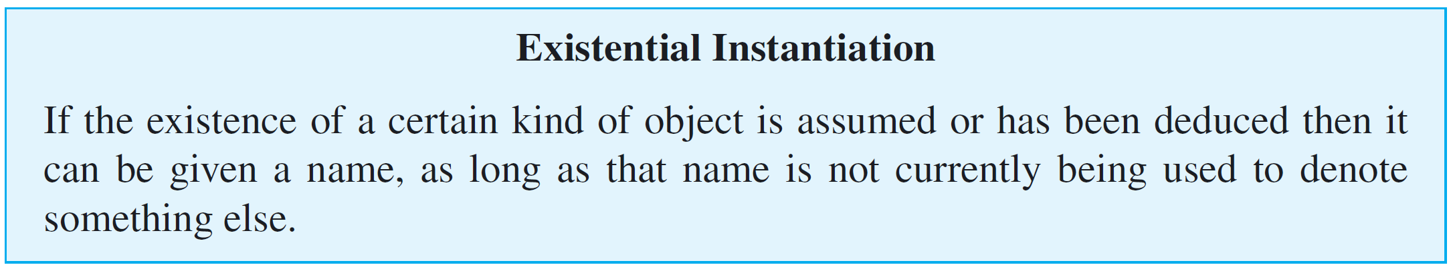
Example 7 – Solution
cont’d
One of the basic laws of logic, called existential instantiation, says, in effect, that if you know something exists, you can give it a name.
However, you cannot use the same name to refer to two different things, both of which are currently under discussion.

Slide 37

Example 7 – Solution
cont’d
Thus since m equals twice some integer, you can give that integer a name, and since n equals twice some integer, you can also give that integer a name:
Now what you want to show is that m + n is even. In other words, you want to show that m + n equals 2  (some integer). Having just found alternative representations for m (as 2r) and n (as 2s), it seems reasonable to substitute these representations in place of m and n:

Slide 38


Example 7 – Solution
cont’d
Your goal is to show that m + n is even. By definition of even, this means that m + n can be written in the form
This analysis narrows the gap between the starting point and what is to be shown to showing that
Why is this true? First, because of the distributive law from algebra, which says that
and, second, because the sum of any two integers is an integer, which implies that r + s is an integer.

Slide 39
Example 7 – Solution
cont’d
This discussion is summarized by rewriting the statement as a theorem and giving a formal proof of it. (In mathematics, the word theorem refers to a statement that is known to be true because it has been proved.)
Such comments are purely a convenience for the reader and could be omitted entirely. For this reason they are italicized and enclosed in italic square brackets: [ ].
Donald Knuth, one of the pioneers of the science of computing, has compared constructing a computer program from a set of specifications to writing a mathematical proof based on a set of axioms.

Slide 40
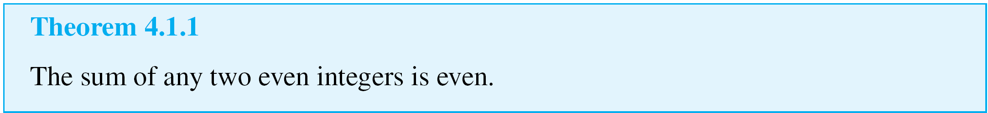
Example 7 – Solution
cont’d
In keeping with this analogy, the bracketed comments can be thought of as similar to the explanatory documentation provided by a good programmer. Documentation is not necessary for a program to run, but it helps a human reader understand what is going on.
Proof:
Suppose m and n are [particular but arbitrarily chosen] even integers. [We must show that m + n is even.]

Slide 41
Example 7 – Solution
cont’d
By definition of even, m = 2r and n = 2s for some integers r and s. Then
Let t = r + s. Note that t is an integer because it is a sum of integers. Hence
It follows by definition of even that m + n is even.
[This is what we needed to show.]

Slide 42
Directions for Writing Proofs of Universal Statements

Slide 43
Directions for Writing Proofs of Universal Statements
Think of a proof as a way to communicate a convincing argument for the truth of a mathematical statement.
Over the years, the following rules of style have become fairly standard for writing the final versions of proofs:
1. Copy the statement of the theorem to be proved on your paper.
2. Clearly mark the beginning of your proof with the word Proof.
3. Make your proof self-contained.

Slide 44
Directions for Writing Proofs of Universal Statements
This means that you should explain the meaning of each variable used in your proof in the body of the proof. Thus you will begin proofs by introducing the initial variables and stating what kind of objects they are.
At a later point in your proof, you may introduce a new variable to represent a quantity that is known at that point to exist.
4. Write your proof in complete, gramatically correct
sentences.
This does not mean that you should avoid using symbols and shorthand abbreviations, just that you should incorporate them into sentences.

Slide 45
Directions for Writing Proofs of Universal Statements
5. Keep your reader informed about the status of each statement in your proof.
Your reader should never be in doubt about whether something in your proof has been assumed or established or is still to be deduced. If something is assumed, preface it with a word like Suppose or Assume.
If it is still to be shown, preface it with words like, We
must show that or In other words, we must show that.
This is especially important if you introduce a variable in rephrasing what you need to show.

Slide 46
Directions for Writing Proofs of Universal Statements
6. Give a reason for each assertion in your proof.
Each assertion in a proof should come directly from the
hypothesis of the theorem, or follow from the definition of
one of the terms in the theorem, or be a result obtained
earlier in the proof, or be a mathematical result that has
previously been established or is agreed to be assumed.
Indicate the reason for each step of your proof using
phrases such as by hypothesis, by definition of . . . , and
by theorem . . . .

Slide 47
Directions for Writing Proofs of Universal Statements
7. Include the “little words and phrases” that make the logic of your arguments clear.
When writing a mathematical argument, especially a proof, indicate how each sentence is related to the previous one.
Does it follow from the previous sentence or from a
combination of the previous sentence and earlier ones? If so, start the sentence by stating the reason why it follows or by writing Then, or Thus, or So, or Hence, or
Therefore, or Consequently, or It follows that, and include the reason at the end of the sentence.

Slide 48
Directions for Writing Proofs of Universal Statements
If a sentence expresses a new thought or fact that does
not follow as an immediate consequence of the preceding
statement but is needed for a later part of a proof,
introduce it by writing Observe that, or Note that, or But,
or Now.
Sometimes in a proof it is desirable to define a new
variable in terms of previous variables. In such a case,
introduce the new variable with the word Let.
8. Display equations and inequalities.
The convention is to display equations and inequalities
on separate lines to increase readability, both for other
people and for ourselves so that we can more easily
check our work for accuracy.

Slide 49
Variations among Proofs

Slide 50
Variations among Proofs
It is rare that two proofs of a given statement, written by two different people, are identical. Even when the basic mathematical steps are the same, the two people may use different notation or may give differing amounts of explanation for their steps, or may choose different words to link the steps together into paragraph form.
An important question is how detailed to make the explanations for the steps of a proof. This must ultimately be worked out between the writer of a proof and the intended reader, whether they be student and teacher, teacher and student, student and fellow student, or mathematician and colleague.

Slide 51
Common Mistakes

Slide 52
Common Mistakes
The following are some of the most common mistakes people make when writing mathematical proofs.
1. Arguing from examples.
Looking at examples is one of the most helpful practices
a problem solver can engage in and is encouraged by all
good mathematics teachers.
However, it is a mistake to think that a general
statement can be proved by showing it to be true for
some special cases. A property referred to in a universal
statement may be true in many instances without being
true in general.

Slide 53
Common Mistakes
2. Using the same letter to mean two different things.
Some beginning theorem provers give a new variable quantity the same letter name as a previously introduced variable.
3. Jumping to a conclusion.
To jump to a conclusion means to allege the truth of something without giving an adequate reason.
4. Circular reasoning.
To engage in circular reasoning means to assume what is to be proved; it is a variation of jumping to a conclusion.

Slide 54
Common Mistakes
5. Confusion between what is known and what is still to
be shown.
A more subtle way to engage in circular reasoning
occurs when the conclusion to be shown is restated
using a variable.
6. Use of any rather than some.
There are a few situations in which the words any and
some can be used interchangeably.

Slide 55
Common Mistakes
7. Misuse of the word if.
Another common error is not serious in itself, but it reflects imprecise thinking that sometimes leads to problems later in a proof. This error involves using the word if when the word because is really meant.

Slide 56
Getting Proofs Started

Slide 57
Getting Proofs Started
Believe it or not, once you understand the idea of generalizing from the generic particular and the method of direct proof, you can write the beginnings of proofs even for theorems you do not understand.
The reason is that the starting point and what is to be shown in a proof depend only on the linguistic form of the statement to be proved, not on the content of the statement.

Slide 58
Example 8 – Identifying the “Starting Point” and the “Conclusion to Be Shown”
Write the first sentence of a proof (the “starting point”) and the last sentence of a proof (the “conclusion to be shown”) for the following statement:
Every complete, bipartite graph is connected.
Solution:
It is helpful to rewrite the statement formally using a quantifier and a variable:
Formal Restatement:

Slide 59
Example 8 – Solution
cont’d
The first sentence, or starting point, of a proof supposes the existence of an object (in this case G) in the domain (in this case the set of all graphs) that satisfies the hypothesis of the if-then part of the statement (in this case that G is complete and bipartite).
The conclusion to be shown is just the conclusion of the if-then part of the statement (in this case that G is connected).

Slide 60
Example 8 – Solution
cont’d
Starting Point: Suppose G is a [particular but arbitrarily
chosen] graph such that G is complete and
bipartite.
Conclusion to Be Shown: G is connected.
Thus the proof has the following shape:
Proof:
Suppose G is a [particular but arbitrarily chosen] graph such that G is complete and bipartite.
Therefore, G is connected.
…

Slide 61
Showing That an Existential Statement Is False

Slide 62
Showing That an Existential Statement Is False
We have known that the negation of an existential statement is universal.
It follows that to prove an existential statement is false, you must prove a universal statement (its negation) is true.

Slide 63
Example 9 – Disproving an Existential Statement
Show that the following statement is false:
There is a positive integer n such that n² + 3n + 2 is prime.
Solution:
Proving that the given statement is false is equivalent to proving its negation is true.
The negation is
For all positive integers n, n² + 3n + 2 is not prime.
Because the negation is universal, it is proved by generalizing from the generic particular.

Slide 64
Example 9 – Solution
cont’d
Claim: The statement “There is a positive integer n such
that n² + 3n + 2 is prime” is false.
Proof:
Suppose n is any [particular but arbitrarily chosen] positive integer. [We will show that n² + 3n + 2 is not prime.]
We can factor n² + 3n + 2 to obtain
n² + 3n + 2 = (n + 1)(n + 2).
We also note that n + 1 and n + 2 are integers (because they are sums of integers) and that both n + 1 > 1 and
n + 2 > 1 (because n ≥ 1).Thus n² + 3n + 2 is a product of two integers each greater than 1, and so n² + 3n + 2 is not prime.

Slide 65
Conjecture, Proof, and Disproof

Slide 66
Conjecture, Proof, and Disproof
More than 350 years ago, the French mathematician Pierre de Fermat claimed that it is impossible to find positive integers x, y, and z with x^{n} + y^{n} = z^{n} if n is an integer that is at least 3. (For n = 2, the equation has many integer solutions, such as 3² + 4² = 5² and 5² + 12² = 13².)
Fermat wrote his claim in the margin of a book, along with the comment “I have discovered a truly remarkable PROOF of this theorem which this margin is too small to contain.”

Slide 67
Conjecture, Proof, and Disproof
No proof, however, was found among his papers, and over the years some of the greatest mathematical minds tried and failed to discover a proof or a counterexample, for what came to be known as Fermat’s last theorem.
One of the oldest problems in mathematics that remains unsolved is the Goldbach conjecture. In Example 5 it was shown that every even integer from 4 to 26 can be represented as a sum of two prime numbers.
More than 250 years ago, Christian Goldbach (1690–1764) conjectured that every even integer greater than 2 can be so represented.

Slide 68
Conjecture, Proof, and Disproof
Explicit computer-aided calculations have shown the conjecture to be true up to at least 10¹⁸. But there is a huge chasm between 10¹⁸ and infinity.
As pointed out by James Gleick of the New York Times, many other plausible conjectures in number theory have proved false.
Leonhard Euler (1707–1783), for example, proposed in the eighteenth century that a⁴ + b⁴ + c⁴ = d⁴ had no nontrivial whole number solutions.

Slide 69
Conjecture, Proof, and Disproof
In other words, no three perfect fourth powers add up to another perfect fourth power. For small numbers, Euler’s conjecture looked good.
But in 1987 a Harvard mathematician, Noam Elkies, proved it wrong. One counterexample, found by Roger Frye of Thinking Machines Corporation in a long computer search, is 95,800⁴ + 217,519⁴ + 414,560⁴ = 422,481⁴.

